Slide 1
Crowd sourcing of diseases and pest information
PIP2001 Capstone Project
Viva-Voce
Batch Number : CSE-G53
Roll Number | Student Name
Under the Supervision of,
Dr . Iqbal Gani Dar
Professor
School of Computer Science and Engineering
Presidency University
20211CSE0119 | Sajjanagandla Varun
20211CSE0103 | P. Vishnu Vardhan Reddy
20211CSE0131 | N. Durga Prasad
20211CSE0181 | M. Sandeep Kumar Reddy
Name of the Program: B.TECH
Name of the HoD: Dr. Blessed Prince P/Dr. Robin Rohit/Dr. Asif Mohammed H.B
Name of the Program Project Coordinator: Mr. Amarnath J.L & Dr. Jayanthi K
Name of the School Project Coordinators: Dr. Sampath A K / Dr. Abdul Khadar A / Mr. Md Ziaur Rahman

Slide 2
Introduction
In modern agriculture, timely identification and management of pests and diseases are critical to ensuring crop health and food security.
This project focuses on developing a Crowdsourcing Platform that enables farmers and agricultural experts to collaborate by sharing real-time information on pest and disease outbreaks. The platform will allow users to report pest or disease incidents from various regions, upload images, and provide descriptions.
By leveraging the power of crowdsourcing, this system aims to bridge the gap between remote farmers and agricultural expertise.

Slide 3
Literature Review
Plant pests and diseases are a significant threat to almost all major types of plants and global food security. Traditional inspection across different plant fields is time-consuming and impractical for a wider plantation size, thus reducing crop production.
Farmers are supposed to attain expert knowledge and thorough training to distinguish early plant pests or viral symptoms and take appropriate action to prevent disease continuity.
Researchers have utilized many diverse methods for identifying plant diseases in addition to the more common machine learning and CNN-based approaches.

Slide 4
Research Gaps Identified
Lack of Expertise in Contributors: Since crowdsourcing relies on voluntary contributions from the public, the data submitted can vary in quality. Non-expert users might provide inaccurate or incomplete information, leading to false conclusions.
Limited Data Validation: Existing methods often lack robust mechanisms for verifying the accuracy of the crowdsourced data. While some systems may use AI to filter data, false information can still slip through.
Time Lag in Data Processing: Some crowdsourcing platforms are not designed for real-time data processing. This can lead to delays between when data is submitted and when it is analysed or acted upon.

Slide 5
Proposed Methodology
Develop a mobile application and a corresponding web portal for users (farmers, expertise, admins) to report pest or disease occurrences. The app would allow users to submit geotagged photos, descriptions of the problem, location data, additional data like crop type, symptoms or affected areas.
Provide contributors with user-friendly tutorials, visual guides, and resources to help them identify pests or diseases more accurately.
To address the issue of fake contributors, verification of submissions will be carried out by the admin. By implementing a manual verification process, the system ensures that only accurate and legitimate information is accepted, minimizing the impact of false reports.

Slide 6
Objectives
Facilitate Real-time Reporting of Pests and Diseases: Enable farmers and field workers to report pest and disease incidents in real-time, including uploading images and descriptions for accurate identification.
Create a Collaborative Knowledge Base : To develop a centralized platform where users can contribute and access verified information about pest and disease occurrences, forming a dynamic and localized knowledge repository.
Provide Access to Expert Advice: Incorporate a feature where agricultural experts can review reports and share best practices to help manage specific pest and disease issues.

Slide 7
System Design & Implementation
Mobile Application:
To develop a mobile app using android studio for farmers and citizens to report sightings of diseases or pests.
Geotagging:
Automatically captures the location of the report.
Photo Upload:
Users can submit images of affected plants.
SMS-Based Reporting: Useful in areas with limited internet access. Farmers can report pest or disease incidents via SMS.

Slide 8
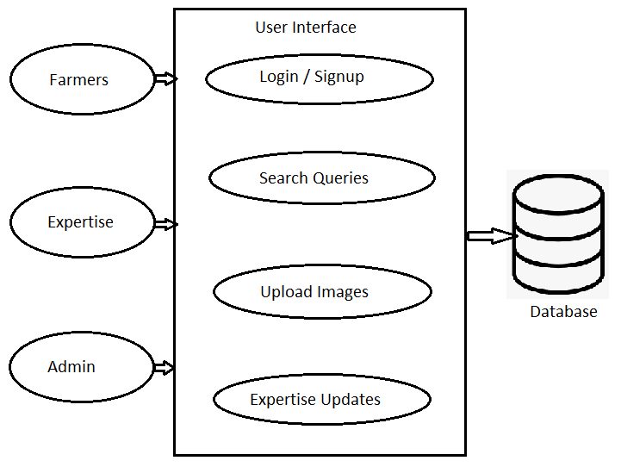
System Design & Implementation

Slide 9
System Design & Implementation
Mobile Application :
Android Studio
Database :
MySQL Database
Geo Location Services :
Google maps API
Analytics and Reporting:
Power BI

Slide 10
Timeline of Project
 | October | November | December | January
Analysis
Design
Develop
Deployment

Slide 11
Outcomes/Results Obtained
Develop a robust database schema that efficiently stores and retrieves pest and disease data, ensuring quick access and scalability.
Easy access to expert advice through the platform without needing to travel or wait for help.
Increased Yield and Agricultural Productivity and increase farmers income.
Community Knowledge Sharing and giving professional advice and recommendations.
Less crop damage by quick reporting and advising farmers.

Slide 12
Conclusion
The crowdsourcing project for disease and pest information holds significant potential for transforming the way we monitor, manage, and respond to agricultural and public health threats. By utilizing mobile apps, SMS reporting, data integration tools the project empowers farmers, researchers, and citizens to actively participate in identifying and reporting cases of pests and diseases. This decentralized approach enables rapid detection, supports timely response efforts, and creates a comprehensive solutions for diverse locations.

Slide 13
References
[1] Pethuraj, S., & Selvaraj, R. (2019). A review on the role of crowdsourcing in plant disease and pest management. Agricultural Systems, 177, 102717.
[2] Ramcharan, M., MacDonald, A., & Moosavi, N. (2019). Crowdsourced data for pest and disease detection in agriculture: A review of applications and techniques. Precision Agriculture, 20(4), 706-726.
[3] Carranza, J. C., Pratap, A., & Goldstein, A. (2021). PlantVillage: A mobile app for disease diagnosis using image recognition. Computers and Electronics in Agriculture, 181, 105924.
[4] Goel, R., Rani, R., & Chauhan, S. (2020). A mobile-based approach to pest surveillance using real-time data and image recognition techniques in agriculture. Computers and Electronics in Agriculture, 173, 105396.
[5] Haklay, M. (2020). Citizen science and the role of crowdsourcing in environmental monitoring. Journal of Environmental Management, 129, 265-276.

Slide 14
References
[6] Freitag, M., & Tullis, R. (2016). Enhancing user engagement in crowdsourcing platforms: Challenges and opportunities. International Journal of Human-Computer Studies, 96, 104-121.
[7] Yadav, R., Jha, M., & Ghosh, D. (2018). Impact of video tutorials on knowledge transfer for sustainable farming practices: A case study in rural India. Sustainable Agriculture Research, 7(1), 70-84.
[8] Goel, P., & Sharma, D. (2020). Multilingual agricultural applications: Improving accessibility and inclusiveness through localized platforms. International Journal of Agricultural Technology, 16(1), 191-201.
[9] Rajendran, A., & Bhatnagar, P. (2017). Emerging technologies in agricultural mobile applications for real-time disease and pest management. Journal of Agricultural Informatics, 8(3), 7-15.

Slide 15
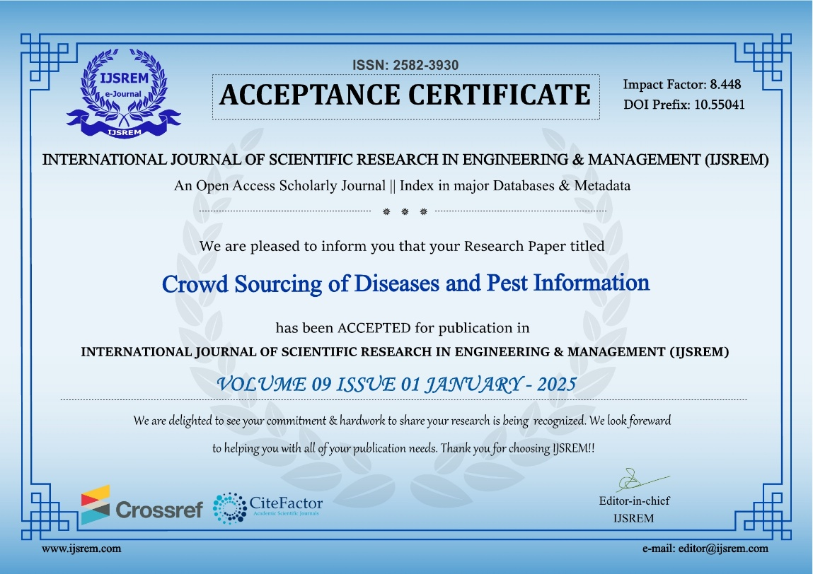
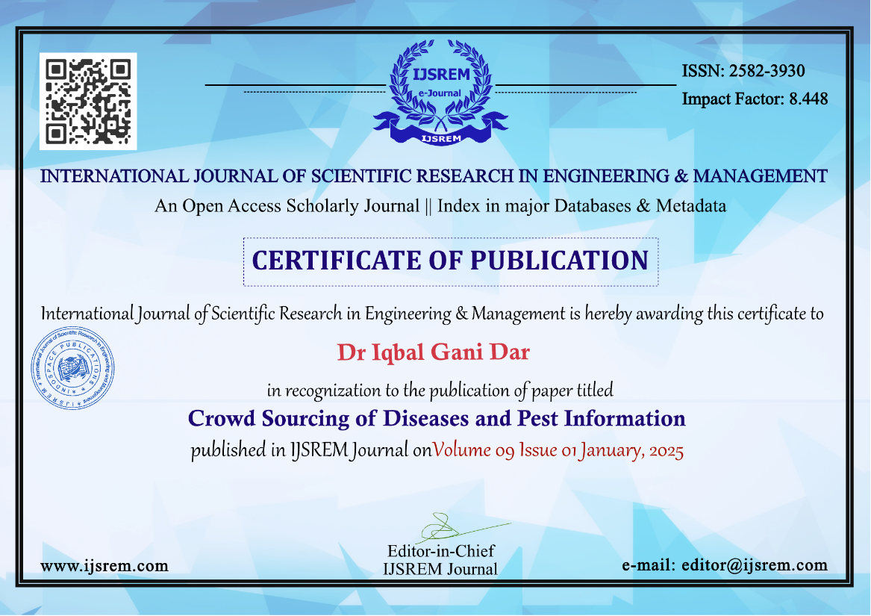
Publication Details
Journal : International Journal of Scientific Research in Engineering and Management (IJSREM)

Slide 16
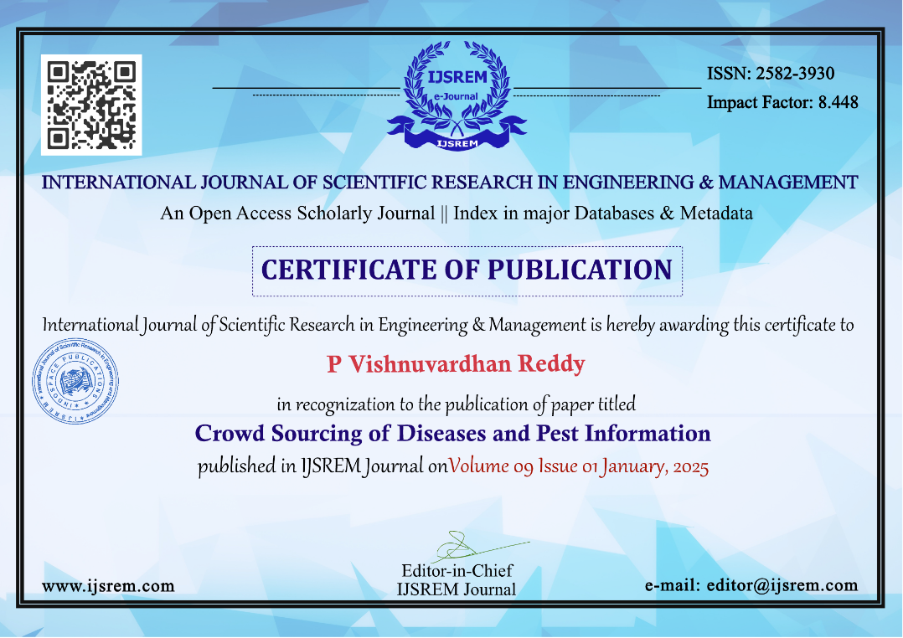

Publication Details

Slide 17


Publication Details

Slide 18
Thank You

